Slide 1
ETL project #1
Goodreads and amazon book review database creation

Slide 2



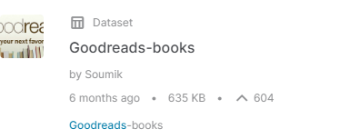
Data sources
EXTRACT
Amazon book data from NovelRank.com (shut down by Amazon in 2018 but available on data.world)
Goodreads review data obtained from Kaggle.com
Data sources were large CSV files containing average review rating, number of reviews, and book titles
Unique data on total sales came from NovelRank so data is a little dated

Slide 3

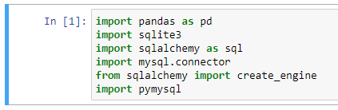

CLEANING PROCESS
TRANSFORM
Pd.merge
Pd.read_csv
Mysql.connector
Create_engine
Sqlite
Remove redundancies
Encoding
Renamed columns
Drop.na
Discrepancies:

Slide 4
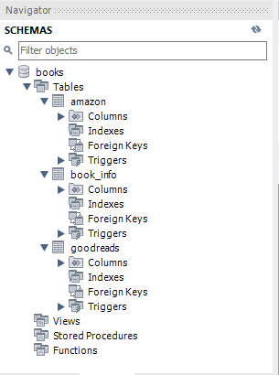

MySQL
LOAD
Mysql.connector
Create_engine & sqlite
Relational database
Schema: books

